Slide 1
Leveraging Machine Learning in Video Surveillance for Crime Detection
Chandana Thirunagari
255815380

Slide 2
Table of Contents
Introduction
Data Preprocessing
Exploratory data analysis
Model Architectures and results
Comparison of models
Conclusion

Slide 3
Why Machine Learning (ML) is Crucial for Effective Crime Detection ?
Machine learning algorithms can analyze large volumes of video data for suspicious activities
They can identify patterns and anomalies that may indicate criminal behavior
ML can assist in real-time monitoring and alerting for potential security threats

Slide 4
Challenges of Traditional Methods in Crime Detection & Benefits of CNN and LSTM
Challenges of Traditional Methods:
Limited Scope & Flexibility: Often relies on fixed rules and manual analysis, struggling to adapt to new or diverse criminal activities.
High False Positives/Negatives: Manual systems can generate inaccurate results, leading to inefficient use of resources.
Data Overload: Difficulty processing large volumes of data from various sources, causing delays in detection and response.
Inadequate Pattern Recognition: Limited ability to identify complex or subtle patterns in data.
Limited Predictive Capability: Focuses on reactive measures rather than proactive, predictive analytics.
Choosing CNN and LSTM for Anomaly Detection:
Advanced Pattern Recognition: CNNs excel at detecting spatial patterns in video data, while LSTMs handle temporal sequences, capturing trends and anomalies over time.
Improved Accuracy: Reduced false positives/negatives through complex pattern recognition and continuous learning.
Handling High Data Volumes: Efficient processing of large datasets enables real-time anomaly detection and response.
Predictive Capabilities: LSTMs leverage historical data to predict future anomalies, enhancing proactive measures.
Flexibility & Adaptability: CNNs and LSTMs adapt to new types of criminal activities and evolving patterns, ensuring ongoing effectiveness.

Slide 5
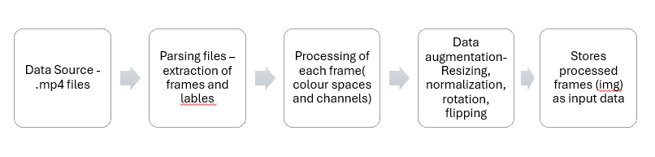
Data Preprocessing
The dataset comprises videos categorized into seven classes: abuse, arrest, assault, burglary, fighting, robbery, and normal activities, each with multiple MP4 files.
Frames are extracted at regular intervals from each video, converting video data into images for processing.
To enhance model robustness:
Random Horizontal Flipping- Images are flipped horizontally with a 50% chance.
Random Rotation- Images are rotated randomly within a specified range.
Resizing- All images are resized to 224x224 pixels.
Normalization- Pixel values are scaled to a range of 0 to 1.
Transformation Pipeline- The pipeline includes resizing to 224x224 pixels, normalization, and conversion of images to tensors for model input.

Slide 6
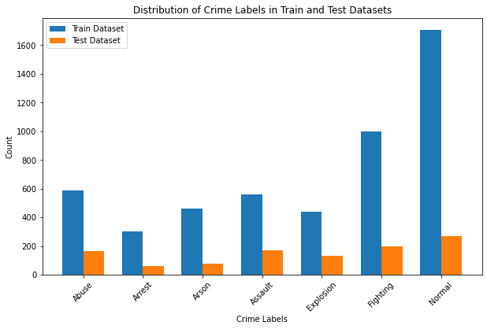
EDA(Exploratory Data Analysis)
Train and Test distribution ratio – 8:2
7 classes - Abuse, Arrest, Arson, Assault, Explosion,
Fighting, and Normal
Total number of train frames: 5050
Total number of test frames: 1065

Slide 7
Methodology
Define the model – architecture of model with layers and hyper parameters
Training loop for each epoch-trained on mini batches of data in each epoch
Testing data preparation – test data sent to model
Model evaluation metrics – epoch accuracy, loss curve analysis

Slide 8
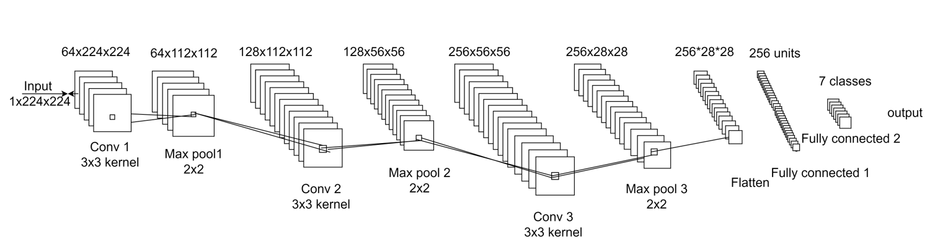
CNN Model
Input Layer: Frames of size 224x224 pixels.
Convolutional Layers: Multiple layers with filters to extract features, using ReLU activation to introduce non-linearity and mitigate vanishing gradients
Max-Pooling Layer: Reduces spatial dimensions using a 2x2 pooling size to decrease computational load and overfitting.
Flattening: Converts the final feature map into a 1D vector
Fully Connected Layers: Two layers process the flattened features.
Output Layer: 7 nodes for class probabilities.
Hyperparameters: Learning rate of 0.1, Adam optimizer.

Slide 9
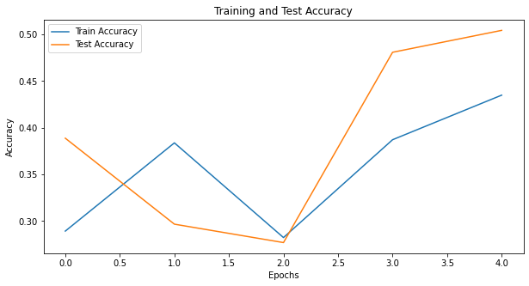
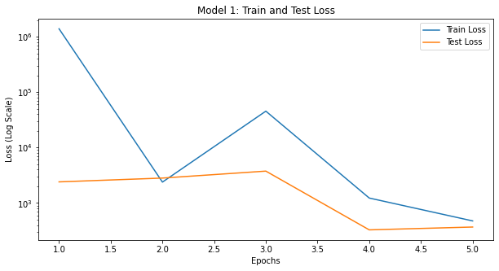
Evaluation of Model 1
The model's training accuracy improves with epochs but peaks at 50%, indicating potential overfitting. Test accuracy starts higher but diverges from training accuracy, showing inconsistent performance.
Train loss starts high, decreases sharply, then increases and decreases again, showing fluctuating performance.
Test loss also starts high, remains constant, then drops before rising slightly, suggesting possible overfitting or model configuration issues.
As Metrics are low and loss of data is high, prompting updates with regularization and architectural adjustments for better generalization.

Slide 10
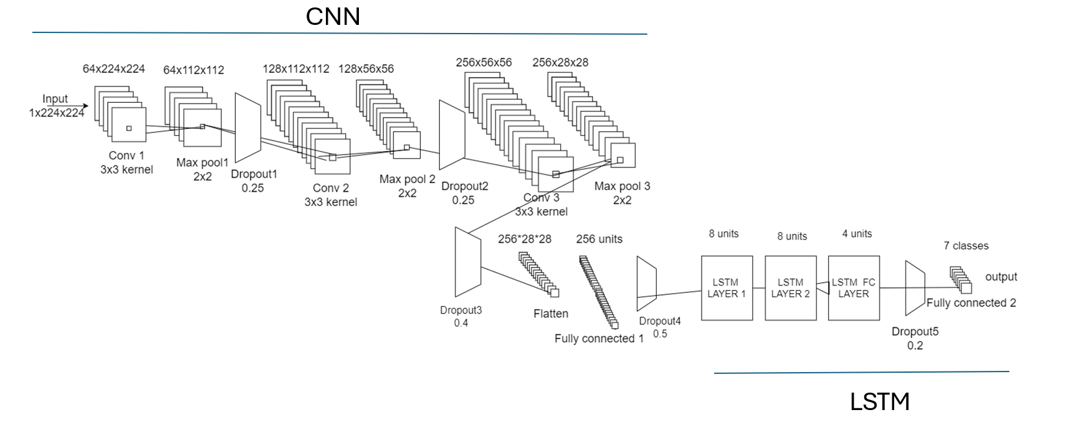
Hybrid Model – CNN + LSTM
Convolutional Layers: Similar to Model 1, with 3 convolutional layers using filters to extract features. LeakyReLU activation (rate 0.01) handles negative values. Max-pooling is applied with a 2x2 size.
Dropout Layers: Dropout rates of 0.25 after the first two max-pooling layers, 0.4 after the third, and 0.5 after flattening are used to prevent overfitting
Flattening: Converts the output into a 1D vector for the LSTM module.
LSTM Module:
- The first LSTM layer reduces feature dimensions from 1 to 8.
- The second LSTM layer processes these 8-dimensional features.
- Dropout rate of 0.2 is applied between LSTM layers.
Hyperparameters:
- Learning rate: 0.001, fixed for high training accuracy and good test generalization.
- Learning rate scheduler: Reduces the rate by 0.1 every 10 epochs

Slide 11
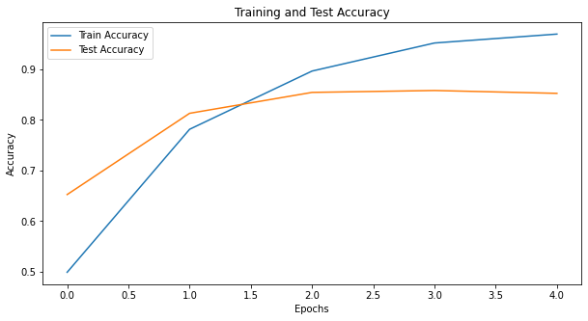
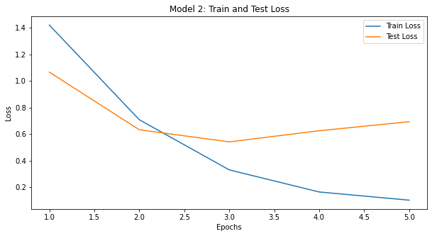
Evaluation of Model 2
Train accuracy starts just above 0.5 and steadily increases to nearly 1.0, indicating good learning on the training data. Test accuracy begins slightly below 0.6 and improves to around 0.9, suggesting the model generalizes well to new data. Both accuracy curves show an upward trend, reflecting strong learning and generalization.
Train loss starts high and decreases steadily to just above 0, indicating effective learning and accurate prediction. Test loss begins high and trends downward, showing improvement.
Overall, the model performs well, with test metrics approaching 90%.

Slide 12
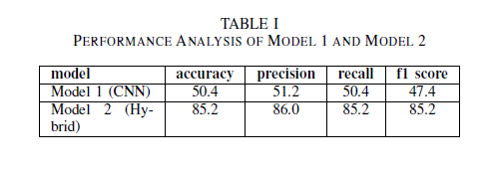
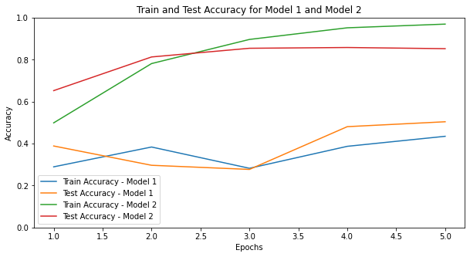
Comparison of Models
The significant performance difference between Model 1 (CNN) and Model 2 (Hybrid) is due to their architectural differences. Model 1, using only CNNs, excels at extracting spatial features but struggles with temporal dependencies crucial for video data. This limitation results in lower and unstable accuracy.
Model 2 integrates CNNs with LSTM networks, capturing both spatial and temporal features. This hybrid approach provides a comprehensive understanding of video sequences, leading to higher accuracy and improved performance in distinguishing between benign and suspicious activities.
Model 2 shows a consistent increase in accuracy over epochs, reflecting its effective learning and generalization capabilities, making it superior for real-time crime detection in video surveillance compared to Model 1.

Slide 13
Conclusion
Successful integration of CNNs and LSTMs in a sophisticated crime detection system, combining strengths in spatial and temporal analysis.
CNN model achieved a peak training accuracy of 50%, while the hybrid CNN+LSTM model reached approximately 86% accuracy on test data.
The hybrid model's ability to integrate spatial and temporal features enables more accurate and reliable crime detection.
Demonstrates significant potential for enhancing public safety through real-time video analysis.
Provides a foundation for future integration and use of IOT devices to alert during crime detection and development in prevention strategies.

